Slide 1




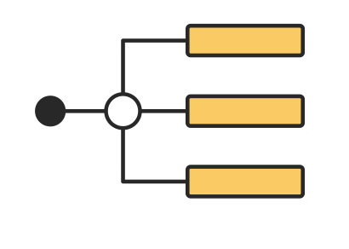
SAT Decision Scraper & Search Application with RAG
Project Client: Josh Tedjasaputra (Customer Experience Insight Pty Ltd)
Notes:
DONE

Slide 2

CONTENTS
01
Introduction
02
Front-end
03
Data and Web scraper
04
RAG
Notes:
DONE

Slide 3

01
Introduction
Notes:
DONE

Slide 4


INTRODUCTION
SAT (State Administrative Tribunal) has published many tribunal decisions and cases over the years.
Cases and decisions are not easy to search.
Our application will benefit Lawyers, Judgers and general public to search or analysis tribunal decisions.
Application applies new AI technologies such as RAG, LLM and web scraper to search and summarize documents intelligently.
Notes:
FIXME

Slide 5
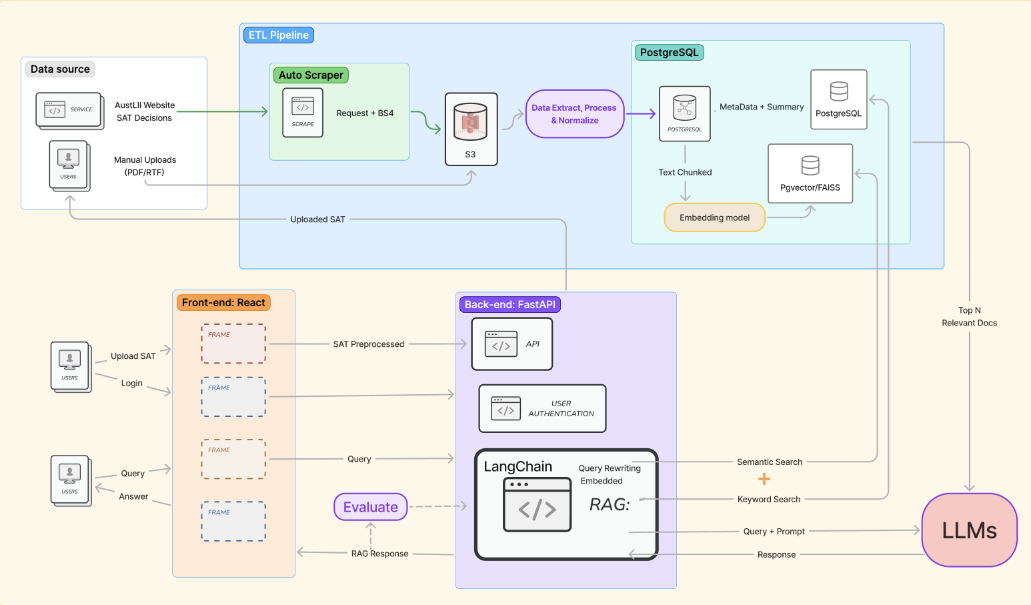
High-level architecture
Project Features
Data source
Database
RAG
Front-end
Notes:
FIXME

Slide 6
02
FRONT-END

Slide 7

FRONT-END
The most popular front-end platform in Australia:
Notes:
FIXME

Slide 8
See npm start!

Slide 9

03
DATA AND WEB SCRAPER

Slide 10
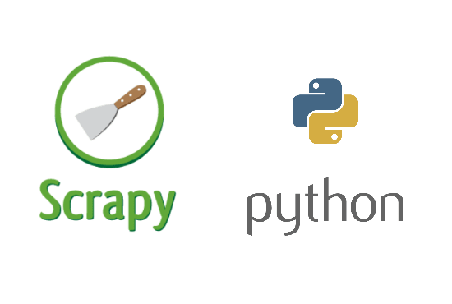
Web scraper
Developed a Python application that automatically scrapes SAT (State Administrative Tribunal) decisions from Austlii database
The web scraping process is performed using Python framework called Scrapy due to its ability to scrape information from multiple webpages at the same time.
Since there are approximately 4000 documents within the database, this makes Scrapy ideal for extracting large amounts of information more efficiently.
Allows developers to create pipelines that export data into CSV, JSON or XML format. Additionally, custom pipelines can be implemented to insert data into databases such as PostgreSQL using libraries such as psycopg2.

Slide 11
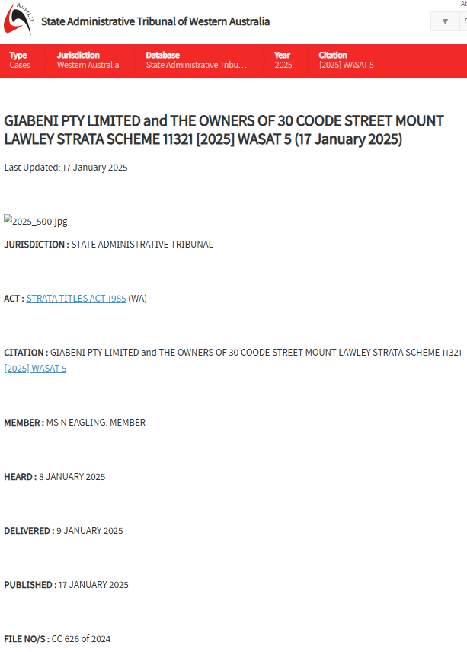
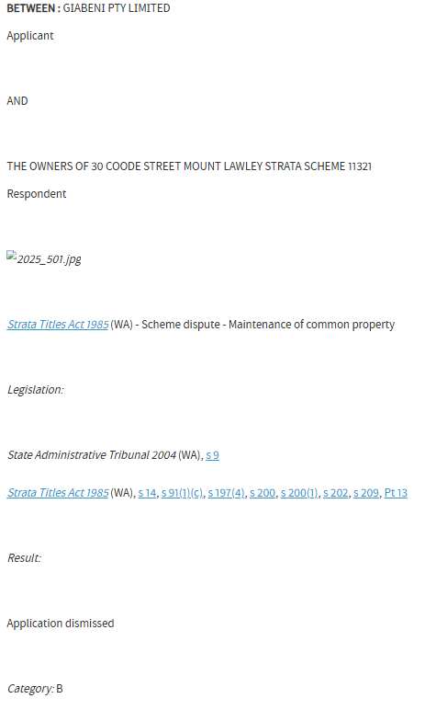
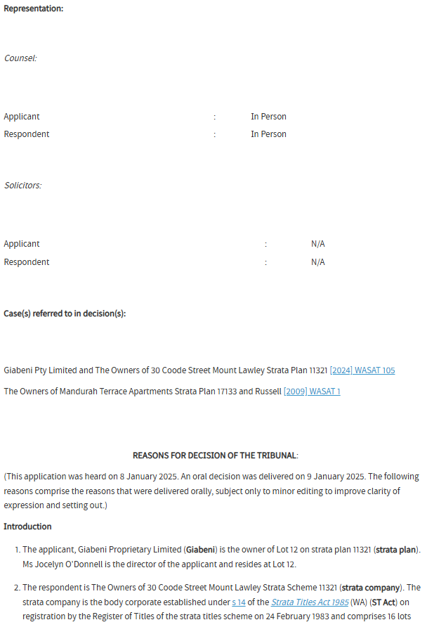
SAT Decision data

Slide 12
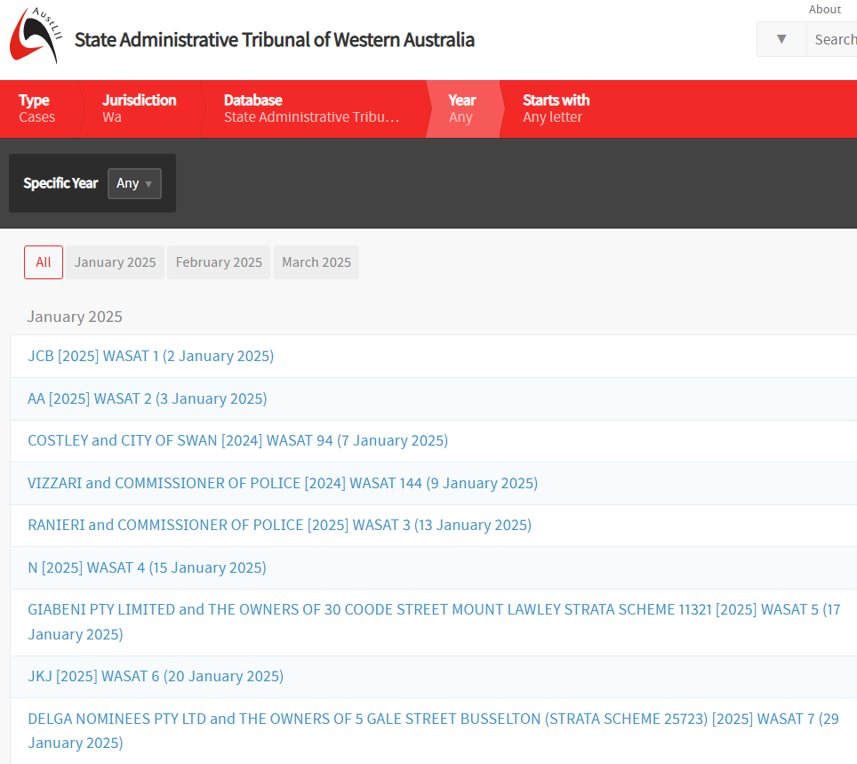


Data extraction process
For the purposes of this demo, only the 2025 data is scraped.
Pipeline is created to preprocess and export all scraped data into JSON format.
Pipeline is created to insert data into PostgreSQL
Scrape Austlii database
Export data as JSON
Insert data into PostgreSQL

Slide 13
Web scraping demonstration

Slide 14


04
R A G

Slide 15
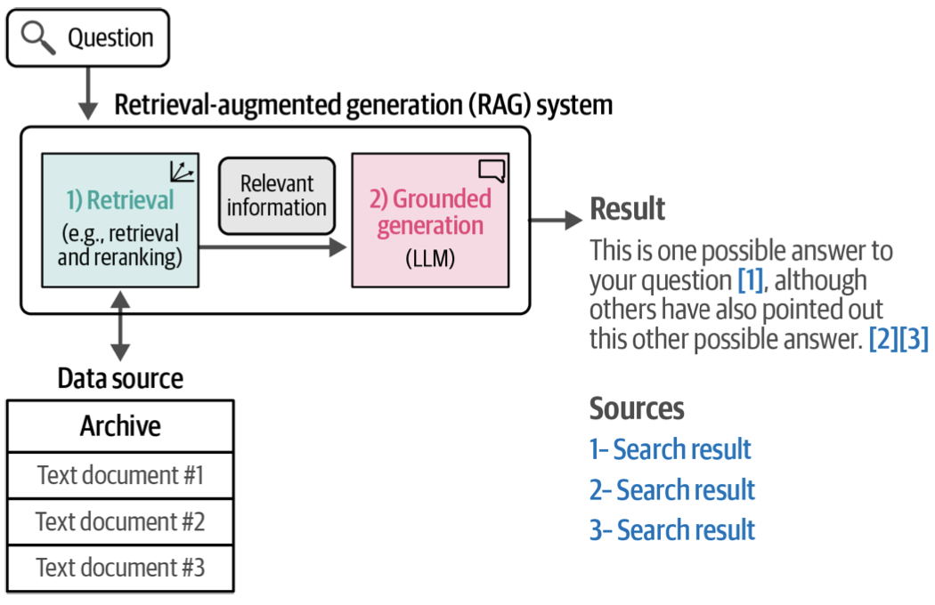
Retrieval-Augmented Generation
Step 1: User Asks a Question
How Our RAG System Works
The system receives a legal question from the user.
Example: "What disputes were heard by WASAT regarding strata schemes?"
Step 2: Retrieval (Search for Relevant Documents)
The system searches a large archive of legal documents.
It finds the most relevant cases using either keyword search or vector search.
The retrieved documents contain real legal information.
Step 3: Grounded Generation (LLM Summarizes the Info)
LLM reads the retrieved documents and summarizes the answer.
It does not generate random text, only information from real legal sources is used
Step 4: Final Answer with Citations
The system provides an answer and includes citations to the original legal cases.
This helps legal professionals verify the response and trust the AI-generated text.
Notes:
demonstrates all major features
showing evidence of strong engineering practices
demonstrated in a non-technical manner with only minimal clarifications needed to understand concepts
"This diagram shows how our system works: First, it searches for relevant legal documents (Step 1). Then, it retrieves the most relevant ones (Step 2). After that, the AI reads the retrieved information and generates a well-grounded answer (Step 3). Finally, the system provides a reliable response with citations (Step 4), ensuring accuracy and transparency."

Slide 16
Experiment: Testing 1000 vs. 5000 Chunks
Retrieval Time | Answer Detail | Context Captured
✅ Fast (~7 sec) | Short & sometimes incomplete | Sometimes lost key legal references
Slower (~12 sec) | ✅ More detailed and accurate | ✅ Preserved more case details & citation
1, 000 chars
5, 000 chars
Test Search Query
I'm a lot owner in a strata scheme and need to understand what types of disputes WASAT typically handles. What cases have they heard recently?
Key Findings
Small chunks (1000 characters) were too fragmented, leading to missing case references.
Large chunks (5000 characters) provided better legal context, ensuring complete case summaries.
Insights
For legal applications, accuracy is more important than speed.
Larger chunks (5000 characters) gave the better balance of accuracy and detail, even though retrieval was slightly slower.

Slide 17
RAG demonstration

